Slide 1
DFSMSrmm Implemenation SS21
DFSMSrmm Implemenation

Slide 2
Course Description
Purpose
  Designed to teach how to implement the Removable Media Manager (DFSMSrmm) functional component of DFSMS/MVS and optional feature of z/OS. DFSMSrmm provides life cycle management of tape data which includes scheduling of tape data which includes scheduling of tape volumes to and from storage locations
Objectives
  Select DFSMSrmm options suitable for your installation
  Create a CDS and journal for DFSMSrmm
  Define DFSMSrmm tape policies (VRS) for retention and movement
  Create procedures for
    Starting DFSMSrmm
    Initializing tapes
    Performing Control dataset backup
  Use DFSMSrmm utility to:
    Produce volume inventory and movement reports
    Perform CDS reorganization
    Perform CDS
  Use SYS1.SAMPLIB sample to produce additional reports.
  Identify access control requirements for using RMM functions.

Slide 3
Unit 1. Introuduction to RMM
Objectives
  Understand rmm terminology
  Identify different types of users for command driven interactions with rmm

Slide 4
What is RMM?
A tape management system
A storage manager for
  Tapes and cartridges
    Physical volumes
    Logical volumes
    Stacked volumes
  Media libraries
  Removable media

Slide 5
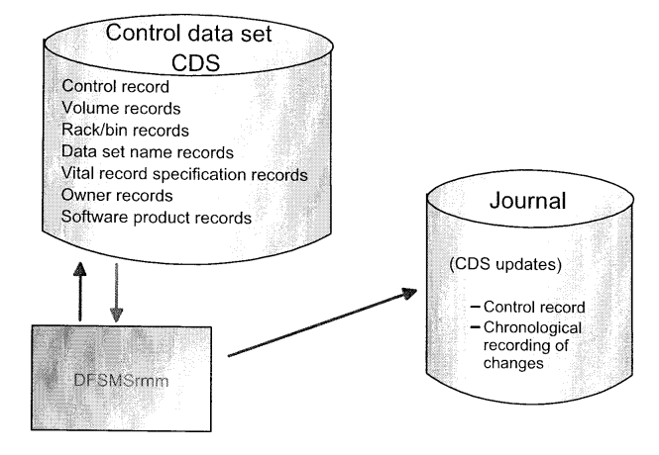
RMM terminology
Notes:
CDS contains following record types:
Control Identifies KSDS as a rmm control dataset
RACK A location may contain a tape volume
Data Set Identifies a specific tape volume (cartridge or reel)
Owner Identifies the owner of a non-scratch volume
VRS Vital Record Specifications: Retention and movement policy for datasets or volumes.
Software Identifies product names and volumes associated with the product

Slide 6
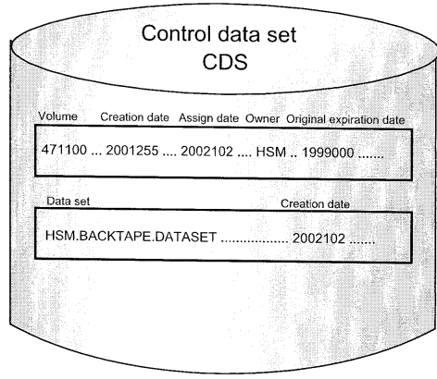
RMM terminology …
Notes:
Creation date The Creation date for dataset is its date written to tape. Updated each time a dataset is replaced without extended.
The Creation date for volume and other resources is the date defined to rmm or specified on the command as creation date.
Assign date The date on which volume was assigned to a user or return to scratch status.
Original expiration date The date supplied via EXPDT or RETPD when a dataset is created.
Owner A person defined as a rmm user owning volumes. An owner is defined to rmm through ID

Slide 7
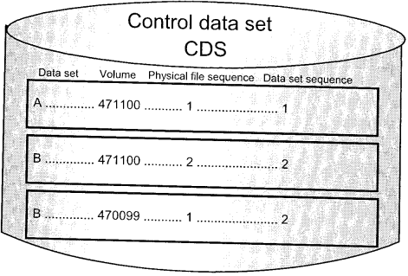
RMM terminology …
Notes:
Physical file sequence Relative position of a file on a volume
Data set sequence Logical position of a dataset relative to others for a multifile single volume or mutilfile/multivolume set.
Example:
Data set name Volume serial Owner File seq Data set sequence
PIBI.IBIPODE.STAGE4RE.P00000.IC.G0068V00 D65044 IBIS001 35 35
PIBI.IBIPODE.STAGE4RE.P00000.IC.G0068V00 D00012 IBIS001 1 35
PIBI.IBIPWH0.BRID1QZO.P00000.IC.G0071V00 D00012 IBIS001 2 36
PIBI.IBIPWH0.DIMR1AIX.P00000.IC.G0053V00 D00012 IBIS001 3 37
………………………………………………………………………………………………………………………………………
PIBI.IBIPWHD.FACT18EV.P00000.IC.G0057V00 D00012 IBIS001 30 64

Slide 8
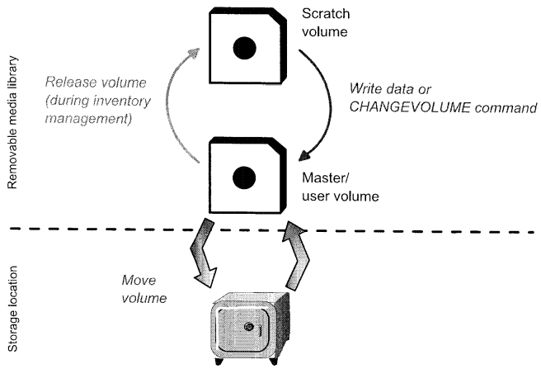
RMM terminology …
Notes:
The status of a volume defined in rmm is subject to change on occasion.

Slide 9
Change of Volume Status
Master
  A private volume containing data protected against overwrite processing based on MASTEROVERWRITE.
Scratch
  The status of a tape volume available for general use, because the data on it has expired
User
  A volume assigned to a user, which can contain any data and can be rewritten as many times as the user wishes until volume expires
Notes:
Note:
Volume status is changed automatically in most cases. Also CHANGEVOLUME can used to amend the status manually.
CHANGEVOLUME can’t change the status from master or user to scratch, but using DELETEVOLUME RELEASE to set volume to pending release. During next inventory management run, volume will change to scratch.

Slide 10
Libraries and Locations
A removable media library contains all tape and optical volumes available for immediate use
A removable media library can include following types of libraries
  System-managed tape libraries. Location (library_name)
    IBM TotalStorage Enterprise Automated Tape Library
    IBM TotalStorage Virtual Tape Server
  Non-system managed tape libraries Location (SHELF,installation_defined)
    Traditional tape libraries
    Other robots

Slide 11
Libraries and Locations…
Storage location can be
  Built-in storage locations
    LOCAL
    DISTANT
    REMOTE
Installation defined storage locations
  Defined by admin maybe. Can be many
Notes:
SHELF/HOME默认的HOME location.

Slide 12
Libraries and Locations…
two types of volume pool in Computing center rack
  TYPE(S) scratch pool
volume in scratch status to satisfy non-specific requests for scratch tapes
  TYPE(R) rack pool
  Volume available for scratch mount requests only if the pool is committed by EDGUX100 or SMS storage group. It can be used for environments where tapes are dedicated to an application calls for all its tapes by specific volser.
Loan location
  Where volume resides other than in the library or storage location. It’s used to tracking of a volume has been manually removed from normal locations managed by rmm.
Notes:
Tape volume in computing center rmm uses a identifier called rack to represent shelf location of a tape. RMM default volser as the rack location. It allow to be different. But for volumes in an IBM system-managed tape library, the rack and volser must match

Slide 13
Libraries and Locations
Acceptable names for bins depend on locations
  Built-in storage locations Name of bins are built of six digits
  Installation defined storage locations Names of bins are built of six alphanumeric or national characters in any combination

Slide 14
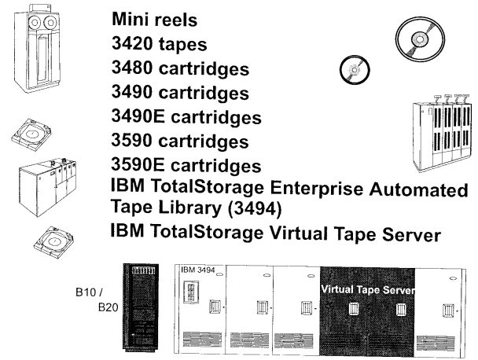
Supported Hardware

Slide 15
Supported Hardware
RMM is a tape management system, and doesn’t manage tape device (tape driver).
The volume record contains fields:
  Media type
  Recording format
  volume type (physical, logical or stacked)
  Media type and recording format are automatically recorded by rmm when volume is used
  for the first time.

Slide 16
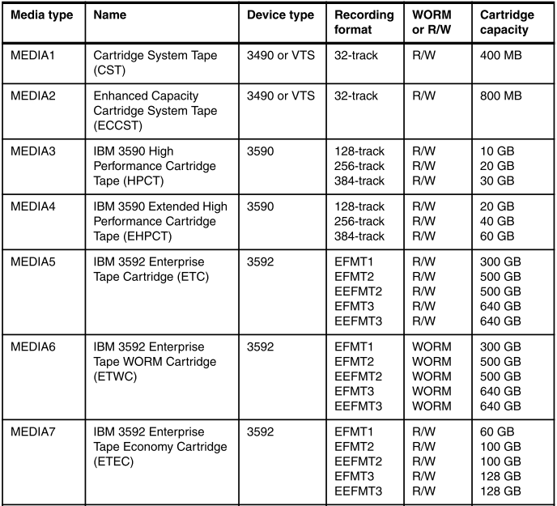
Media Types
Notes:
Some cartridge types can be ope
3590 Media 3,4 = capacity determined by 3590 drive type (B1A ,E1A,H1A) recording format
3592 Media 5 to 10 - capacity determined by 3592 drive type (J1A ,E05 TS1120,E06 TS1130) recording format rated by different hardware device types(drive).
J1A EFMT1
E05 TS1120 (3592 Model E05)
E06 TS1130 (3592 Model E06)
. The 3592 Model E06 is downward-read compatible (n-2) to the 3592 Model J1A format (EFMT1), and the 3592 Model E06 is downward-write compatible (n-1) to the 3592 Model E05 formats (EFMT2/EEFMT2).

Slide 17
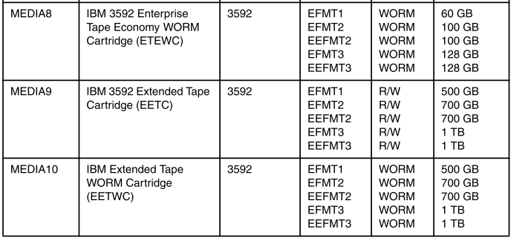

Slide 18
Drives and Supported Media Types
Cartridge type | CST | CST | ECCST | 3590 Standard | 3590 Standard | 3590 Standard | 3590 Extended | 3590 Extended | 3590 Extended
Tracks | 18 | 36 | 36 | 128 | 256 | 384 | 128 | 256 | 384
3480 without IDRC | read& write | rewrite*
3480/3490 with IDRC | read& write | rewrite*
3490E write 36 tracks | read& rewrite* | read& write | read& write
3590 B1x write 128 track |  |  |  | read& write | rewrite* | rewrite* | read& write | rewrite* | rewrite*
3590 E1x write 256 track |  |  |  | read& rewrite* | read& write | rewrite* | read& rewrite* | read& write | rewrite*
3590 H1x write 384 track |  |  |  | read& rewrite* | read& rewrite* | read& write | read& rewrite* | read& rewrite* | read& write
Notes:
*: when rewriting a tape in a format different from the current formrt
Cartridges can be used on several devices having different capabilities such as HPCT on 3590B1x and 3590 E1x.
. The 3592 Model E06 is downward-read compatible (n-2) to the 3592 Model J1A format (EFMT1), and the 3592 Model E06 is downward-write compatible (n-1) to the 3592 Model E05 formats (EFMT2/EEFMT2). All current media types are supported.

Slide 19
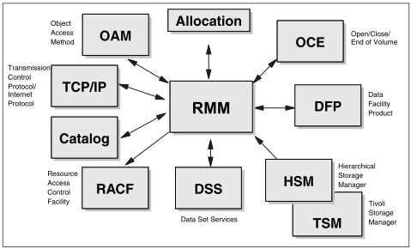
RMM Software Interfaces
Notes:
RMM is a subsystem, this means by which system routines request services of the master subsystem, a JES or other subsystem defined to the subsystem interface.
系统会把request service分发给每个subsystem interface

Slide 20
Reject during Mount Verification
//COPY JOB
//STEP001 EXEC PGM=IEBGENER
//SYSPRINT DD SYSOUT=*
//SYSUT2 DD DSN=OUT.DSN,UNIT=ROBBY,DISP=NEW
//SYSUT1 DD DSN=IN.DATA,DISP=SHR,VOL=SER=DP3RM1,UNIT=3480
If unit ROBBY specify a volume with master or user status, it will be rejected, hindering users from destroying unexpired data.

Slide 21
Reject during Open Processing
//COPY JOB
//STEP001 EXEC PGM=IEBGENER
//SYSPRINT DD SYSOUT=*
//SYSUT2 DD DSN=OUT.DSN,UNIT=ROBBY,DISP=NEW
//SYSUT1 DD DSN=IN.DATA,DISP=SHR,VOL=SER=012347,UNIT=3480
If 012347 volume is a scratch volume, it can’t be used as input.
Rmm protects the contents of volumes with scratch status against any use.
You can use the scratch as input until change its status to master or user.

Slide 22
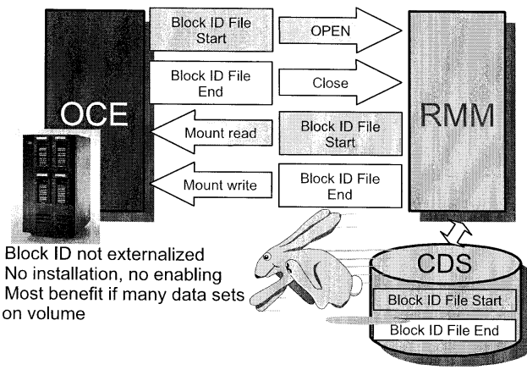
High Speed Locate
Notes:
Rmm records the starting and ending tape block IDs for each data set when it is created in CDS.
In this way, it enables high speed positioning when there’re a large number of datasets in a high capacity cartridge.

Slide 23
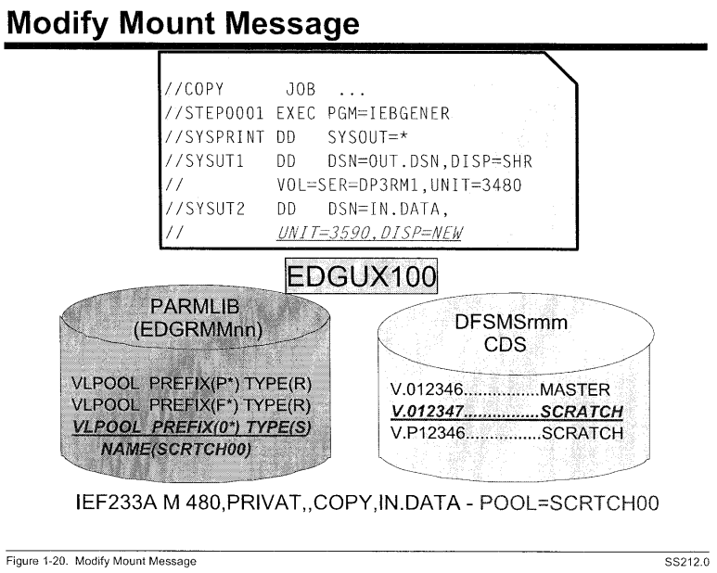
Mount Message
Notes:
IEF233A M 0896,PRIVAT,SL,SMFBIAI1,BKUP001, PR.SMFC.AAIA.IMSDAILY.IM19.TBKUP.G3788V00 - POOL=CD**** (why pickup CD*)
IEF233A M 079D,D40083,,SMFBIAI1,BKUP001, PR.SMFC.AAIA.IMSMTHLY.IM19.TBKUP.G0038V00 - RACK=D40083
To use the pool name in messages, you must specify RACK(999) on the MNTMSG command so that the message is updated at the end of the message text.

Slide 24
Break

Slide 25
Who Can Use DFSMSrmm and How?
General user
  Function
    Manually request a scratch volume
    Change information about an owned volume or dataset
    Update information about your owner ID
    Manually release an owned volume
    Create lists of resources and display information about most resource defined to rmm
  Access
    Read access:
      STGADMIN.EDG.MASTER
      STGADMIN.EDG.RELEASE
Notes:
In fact, we use UACC READ for STGADMIN.EDG.MASTER.

Slide 26
Who Can Use DFSMSrmm and How? .
Tape librarian
  Function
    Define new volumes
    Add shelf locations to the library and locations
    Add, change and delete information about resources defined to rmm
    Manually release any volume
    Manage vital record specification
    Confirm volume movements and actions
  Access need for tape librarian
    Control access
      STGADMIN.EDG.MASTER
      STGADMIN.EDG.LISTCONTROL
      STGADMIN.EDF.VRS
    Update access
      STDADMIN.EDG.FORCE
      STDADMIN.EDG.OPERATOR
      STGADMIN.EDG.INERS.WRONG.LABEL

Slide 27
Who Can Use DFSMSrmm and How? ..
Storage Administrator
  Function
    Define and delete retention and storage policies for datasets and volumes
    Change information about any volume they own, their owner ID, VRS
    Manually request a scratch volume, and release a volume they own
    Create lists of resources and display information about resources defined to rmm
  Access
    Control access
      STGADMIN.EDG.MASTER
      STGADMIN.EDG.LISTCONTROL
      STGADMIN.EDF.VRS
    Update access
      STDADMIN.EDG.FORCE
      STDADMIN.EDG.OWNER.userid

Slide 28
Who Can Use DFSMSrmm and How? ..
System programmer
  Function
    Display parmlib options and control dataset control information
    Add, change and delete information about any volume owner
    Manually request a scratch volume and release a volume they own
    Create a list of software products and display information about any resource.
  Access
    Control access
      STGADMIN.EDG.MASTER
      STGADMIN.EDG.LISTCONTROL
      STGADMIN.EDF.VRS
    Update access
      STDADMIN.EDG.OPERATOR

Slide 29
Who Can Use DFSMSrmm and How? ..
Operator
  Functions
    Fetch and mount tapes from specific pools or shelf locations
    Manually erase and initialize tapes
    Create lists of scratch tapes available for use
  Access
    READ access
      STGADMIN.EDG.MASTER
    Update access
      STDADMIN.EDG.OPERATOR
    ALTER access
      STGADMIN.EDG.RESET.SSI
Notes:
STGADMIN.EDG.RESET.SSI with ALTER provide access to EDGRESET, which is required when removing rmm address space from system

Slide 30
Who Can Use DFSMSrmm and How? ..
Inventory manager
  Functions
    Create an extract of CDS
    Select volumes to be retained and moved as vital records or disaster recovery
    Perform expiration processing
    Perform storage location management processing
    Back up the CDS
  Access
    READ access
      STGADMIN.EDG.MASTER
      STGADMIN.EDG.HOUSEKEEP
      STGADMIN.EDF.HOUSEKEEP.RPTEXT
      STGADMIN.ADR.DUMP.CNCURRNT

Slide 31
Unit 2. RMM Day-to-Day Procedures
Objectives
  To learn operator commands control rmm
  To gain a basic understanding of rmm inventory management
  To learn how to use rmm reporting facilities

Slide 32
2.1 Using Operator Commands to Control RMM

Slide 33
z/OS DFP without Using RMM
Without tape management system, we would be missing a large part of inventory information normally associated with tape data.
  MVS records only unit and volser for cataloged tape data sets.
  No information about dataset, such as expiration or size.
  it actually manages tape volumes rather than the data sets.

Slide 34
Defineing RMM to z/OS
Define RMM ass Subsystem
  JES2 ,,,PRIMARY,NOSTART
  DFRM
  AOPA
As a STC
  SUBSYS SUBNAME(JES2) PRIMARY(YES) START(YES)
  SUBSYS SUBNAME(DFRM)
  SUBSYS SUBNAME(AOPA)
The RMM should start after JES2, before Netview
When decide to use rmm, tape activity should not occur unless rmm is active.
Notes:
At first, we can use manual operation mode (OPTION OPMODE(MANUAL)), by doing so, rmm will start without affecting tape activities, you still can use RMM TSO subcommands, ISPF dialog, and inventory management functions for all type of media. In manual mode, RMM neither records volume usage nor validates volumes.

Slide 35
Commands that Control RMM
Starting rmm
  S DFRMM
  S DFRMM,M=nn
Restarting rmm
  F DFRMM,M=02
  F DFRMM,REFRESH EXITS
Stopping rmm
  P DFRMM
Disabling rmm
  S DFRMM,OPT=RESET
  P DFRMM
Quiescing rmm
  F DFRMM,QUIESCE
Display activities
  F DFRMM,QUERY ACTIVE

Slide 36
Starting RMM
After define rmm as a subsystem, we can start address space.
The sample procedure is EDGDFRMM.
You can enable problem determination aid tracing and logging or not.

Slide 37
Stopping rmm
After stopping rmm when it is in record, warning or protect mode, the SSI prevents tape activities
If a tape dataset is opened or closed, an error message is issued.
  For open, rmm prevents the dataset from being opened until rmm is restarted.
  Continue can be used to allow dataset to be closed, but CDS will loss the update.

Slide 38
Disabling the RMM SSI
Use “S DFRMM,OPT=RESET” to disable the rmm function.
  This can be used when the conversion of current tape management system database into the rmm CDS not work properly. Use RESET mode to analysis.
  Or after clone the system but not the rmm haven’t config properly.
  Run rmm as a subsystem started under the JES2 or JES3 subsystem, rather than under the master subsystem.
  When choosing the DFSMSrmm subsystem name, the subsystem name must not exactly match the DFSMSrmm procedure name, unless you specify SUB=JES2 or SUBJ=JES3 on each START command.

Slide 39
Restarting RMM
Restart RMM to change the mode of operation. F DFRMM,M=nn
During rmm inactive, tape activity will receive a RETRY message for datasets being opened or closed.

Slide 40
Quiescing RMM
Rmm CDS or journal should be de-allocate when performing maintenance or recovery.
Use “F DFRMM,QUIESCE” to suspend activities and de-allocate CDS and journal, and “F DFRMM,M=xx” to restart rmm.

Slide 41
2.2 Inventory Management

Slide 42
Recording when RMM is Active
Automatic recording
  Open/Close/End-of-volume
Manual updating
  ISPF dialog
  TSO RMM subcommands
  API
  Utilities
Creation of SMF records
  Security records
  Audit trail records

Slide 43
Volume Status
Scratch
  Available to be written in response to a non-specific request
  Rmm not allow to be mounted in respond to a specific request regardless of whether request is to read or to write.
  If return to scratch, the data are remain on it. You can recover that kinds of data by change the volume status to master or user.
Master
  A private volume containing data available for write processing based on
  MASTEROVERWRITE
User
  A volume assigned to a user, which can contain any data and be rewritten many times
Notes:
MASTEROVERWRITE(ADD | LAST | MATCH | USER)
Specify to control how DFSMSrmm allows the overwriting of a volume. You can use one of these values:
ADD Specify this value so new data can be created and no existing data can be destroyed. No existing file on a volume can be re-created, but the last file can have new data added to it.
When adding data to the last file, DFSMSrmm checks that the
data set name used must match the existing data set name.
Select this option when you want the last file on the volume to
be extended or a new file added to the volume.
Note: DFSMSrmm enforces the MASTEROVERWRITE(ADD)
option on a WORM tape that is in master status. This is
done to ensure that you see a message from DFSMSrmm
rather than one of a number of symptoms as a result of
the tape drive preventing overwrites.
LAST Specify this value to ensure that when an existing file on a
master volume is being written to that only the last file on the
volume can be used. The data set name used must match the
existing data set name. Select this option when you want the
last file on the volume to be used for output.
MATCH Specify this value to ensure that when an existing file on a
master volume is being used for output that exactly the same
data set name must be used. Select this option when you want
any existing file on the volume to be re-created regardless of
whether it is the last file on the volume as long as the same
data set name is used.
When you use an existing tape file for output all the files that
are higher in sequence are destroyed.
USER Specify this value to allow any existing file on a master volume
to be used for output regardless of the data set names being
used and its relative file position on the volume. Select this
option when you want validation of master volumes to be just
the same as for user status volumes.
When you use an existing tape file for output all the files that
are higher in sequence are destroyed.

Slide 44
MASTEROVERWRITE
ADD
  new data can be created and no existing data can be destroyed. No existing file on a volume can be re-created, but the last file can have new data added to it.
  When adding data to the last file, DFSMSrmm checks that the data set name used must match the existing data set name.
  Select this when last file on the volume will extend or a new file added to the volume.
LAST (Default)
  when an existing file on a master volume is being written to that only the last file on the volume can be used. The data set name used must match the existing data set name.
  Select this option when you want the last file on the volume to be used for output.
MATCH
  when an existing file on a master volume is being used for output that exactly the same data set name must be used.
  Select this option when you want any existing file on the volume to be re-created regardless of whether it is the last file on the volume as long as the same data set name is used.
USER
  Allow any existing file on a master volume to be used for output regardless of the data set names being used and its relative file position on the volume. Select this option when you want validation of master volumes to be just the same as for user status volumes.

Slide 45
Scheduling of RMM Utilities
Actions should scheduled daily
  EDGHSKP
    Process vital records
    Perform expiration processing
    Create an extract data set
    Backup DFSMSrmm CDS, journal
  IDCAMS
    Check DFSMSrmm CDS space utilization
Action should scheduled weekly
  Perform storage location management
  Create volume movement and inventory reports
  Initialize and erase volumes
Action should scheduled monthly
  Create security and audit reports
Action should scheduled Yearly
  Reorganize rmm CDS
Notes:
Following recommend are based on tapes are sent to storage locations weekly.

Slide 46
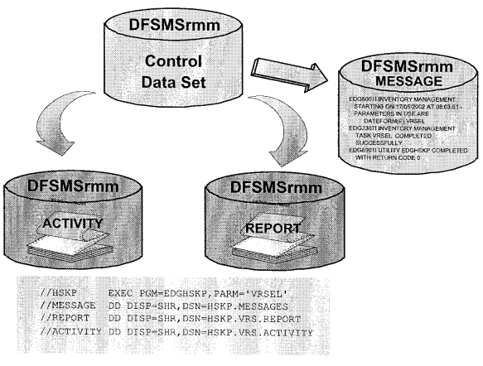
Processing of Vital Records
Notes:
To check VRS that match datasets and to see which dataset are being retained, use PARM=‘VRSEL’
如果修改了VRS，可以先用PARM=‘VRSEL,VERIFY’,检查VRS记录是否是希望得到的，然后再执行VRSEL

Slide 47
Performing Storage Location Management
DSTORE phase assigns a shelf location (bin number).
This is done to volumes moving to and among shelf-managed storage locations and the process sets a destination storage location

Slide 48
Performing Expiration Processing
RMM check expiration date for volumes not managed by a VRS. If reached, rmm change the volume availability to pending release.
RMM checks for any actions should be taken before volume can be released.
When a volume not retained by VRS and reaches its expiration date, it is not immediately returned to scratch or to its owner. Two runs of expiration processing are needed to return a volume.
  First run, set volume availability to pending release. No other information is changed.
  Second run will expire the volume.
Notes:
只有volume没有被VRS retain，同时又达到了expiration date，才会被expire

Slide 49
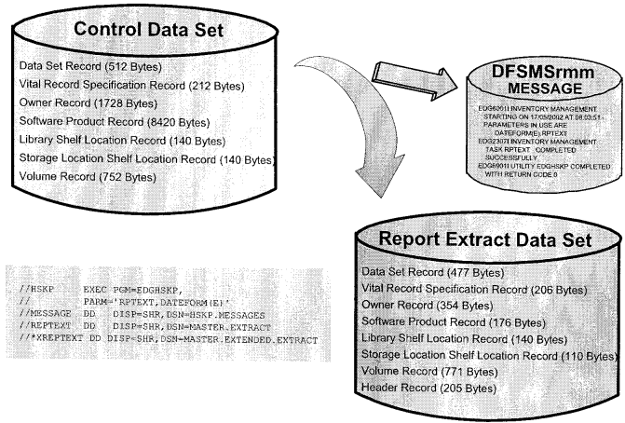
Creating an Extract Data Set
Notes:
The Extract dataset mapping are listed in DFSMSrmm reporting Appendix B. DFSMSrmm Mapping Macros

Slide 50
Backing Up the CDS
EDGHSKP will internal use IDCAMS REPRO to backup CDS and journal if no other PARM specified. And the output should on DASD.
  //STEP1 PGM=EDGHSKP,PARM=‘BACKUP’
  //SYSPRINT DD SYSOUT=*
  //MESSAGE DD DSN=RMM.MASTER.MESSAGE,DISP=SHR
  //BACKUP DD DSN=RMM.MASTER.BACKUP,DISP=(NEW,CATLG),UNIT=DASD
  //JRNLBKUP DD DSN=RMM.JOURNAL.BACKUP,DISP=(NEW,CATLG),UNIT=DASD
  IDCAMS enqueues exclusively the input dataset and make CDS and journal unavailable
  during backup.

Slide 51
Backing Up the CDS
Requesting PARM=‘BACKU(DSS)’ will internally use DSS with keyword CONCURRENT by specified in DSSOPT parm
  //EDGHSKP EXEC PGM=EDGHSKP,PARM=‘BACKUP(DSS)’
  //MESSAGE DD DISP=SHR,DSN=RMM.MESSAGE
  //BACKUP DD DISP=(,CATLG),UNIT=TAPE,DSN=BACKUP.CDS(+1), LABEL=(,SL)
  //JRNLBKUP DD DISP=(,CATLG),UNIT=TAPE,DSN=BACKUP.JRNL(+1),
  LABEL=(2,SL),VOL=REF=*.BACKUP
  //DSSOPT DD *
  CONCURRENT OPTIMIZE(1) VALIDATE

Slide 52
2.3 Reporting Facility of RMM

Slide 53
Available Reports with EDGRPTD
The extract file created by RPTEXT processing phase used by EDGRPTD
  //RPTD EXEC PGM=EDGRPTD,
  // PARM=’SEC(’INTERNAL USE ONLY’’),DATEFORM(I),LINECOUNT(54)’
  //REPTEXT DD DISP=SHR,DSN=RMMTST.PR0914X.REPTEXT
  //SYSPRINT DD SYSOUT=*
  //INSTVOL DD DISP=SHR,DSN=RMMTST.REPORT.INSTVOL
  //INSTBIN DD DISP=SHR,DSN=RMMTST.REPORT.INSTBIN
  //INSTOWN DD DISP=SHR,DSN=RMMTST.REPORT.INSTOWN
  //TOSTRCK DD DISP=SHR,DSN=RMMTST.REPORT.TOSTRCK
  //TOSTOWN DD DISP=SHR,DSN=RMMTST.REPORT.TOSTOWN
  //FMSTBIN DD DISP=SHR,DSN=RMMTST.REPORT.FMSTBIN
  //FMSTOWN DD DISP=SHR,DSN=RMMTST.REPORT.FMSTOWN
  //RDYTOSCR DD DISP=SHR,DSN=RMMTST.REPORT.RDYTOSCR
  //SYSOUT DD DISP=SHR,DSN=RMMTST.REPORT.DFSORT
  //SCRDATE DD DISP=OLD,DSN=RMMTST.LAST.RUN.DATE
  //SCRLIST DD DISP=SHR,DSN=RMMTST.REPORT.SCRLIST
  //NEWSCR DD DISP=SHR,DSN=RMMTST.REPORT.NEWSCR

Slide 54
Available Reports with EDGRPTD
DD Statements for Inventory Reports
  INSTVOL
    Output file for report contains inventory of volumes by location sorted by volser.
  INSTBIN
    Output file for report contains inventory of volumes by location sorted by rack or bin. The storage location report is sort by bin, all other are sorted by rack number.
  INSTOWN
    Output file for report contains inventory of volumes by location sorted by owner.

Slide 55
Available Reports with EDGRPTD
DD Statements for Movement Reports
  FMSTBIN
  output file for movement reports that are sorted by bin number.
    Volumes to be moved between storage locations
    Volumes to be moved from storage locations to SHELF
    Volumes to be moved from storage locations to system-managed tape libraries
  FMSTOWN
  an output file for movement reports that are sorted by owner. The volumes are the same with FMSTBIN
  RDYTOSCR
  An output file for movement reports sorted in ascending order by rack report column which can be either a bin or rack number.
  RDYTOSCR includes information about volumes to be moved from locations to home. RDYTOSCR excludes volumes listed in READY-To-Scratch report from either TOSTRCK or FMSTBIN
  TOSTOWN
    output file for movement reports that are sorted by owner.
    Volumes to be moved from SHELF to storage location
    Volumes to be moved from system-managed libraries to storage locations
    Volumes to be moved between system-managed libraries
  TOSTRCK
    output file for movement reports that are sorted by rack number. The volumes are the same with TOSTOWN

Slide 56
Available Reports with EDGRPTD
DD Statements for Scratch List Reports
  NEWSCR
  output file for the listing of all scratch volumes returned to scratch status since the last scratch list was produced. DFSMSrmm produces the NEWSCR file when there is a valid date and time in the SCRDATE file or the SCRDATE file contains no record.
  SCRDATE
  This file is used to produce the scratch list report. Each time a scratch list report is produced, DFSMSrmm updates the SCRDATE file with the highest scratch date and time for a volume. DFSMSrmm uses the date and time to determine which volumes to include in the new scratch list report.

Slide 57
Extended Report Extract Data Set
Rmm report utility EDGRPTD does not provide any dataset reports. IBM supplies some sample reports for extended reporting.
One set is created from an extended report extract file.
Extended report extract file can be created by REPTEXT during housekeeping

Slide 58
Extended Reporting
REPORT01 Pull list for SCRATCH tapes sorted by volume serial number
REPORT02 Pull list for SCRATCH tapes sorted by data set name
REPORT03 Inventory list by volume serial number
REPORT04 Inventory list by data set name
REPORT05 Inventory of data sets including used kilobytes
REPORT06 Inventory of volume serial numbers by location
REPORT07 Inventory of data set names by location
REPORT08 Inventory of bin numbers by location
REPORT09 List all data set names residing in a loan location
REPORT10 List all volume serial numbers residing in a loan location
REPORT11 List all multivolume and multifile sets
REPORT12 Movement report sorted by data set name
REPORT13 Movement report sorted by bin number
REPORT14 Movement report sorted by volume serial number
REPORT15 Inventory list by volume including volume count
REPORT16 Inventory of Duplicate Volume

Slide 59
Reporting with DFSORT
TO DO

Slide 60
Report Generator
TO DO

Slide 61
Work with Reports
TO DO

Slide 62
Report Type
TO DO

Slide 63
Unit 3. RMM implementation Considerations
Objectives
  Define rmm CDS
  Define rmm journal
  Create rmm proclib members
  Modify MVS parmlib members to support RMM
  Create rmm parmlib member
  Identify rmm exits may be needed for enviornment
  Identify rmm considerations when creating HSM tapes

Slide 64
3.1 RMM data sets, Procedures, and PARMLIB entries

Slide 65
RMM CDS Size
Control Data Set Content | DASD Space
Control record | 1 MB
Data sets | 512 KB for every 1000 data sets
Shelf locations in the library without volumes | 140 KB for every 1000 shelf locations
Shelf locations in storage locations | 140 KB for every 1000 shelf locations
Owners | 38 KB per 1000 volumes
Software products, average five volumes per product | 420 KB for every 1000 software products
Volumes | 1 MB for every 1000 volumes
Vital record specifications | 212 KB for every 1000 vital record
Notes:
The control record size has changed from 1KB to 1MB

Slide 66
RMM control data set allocation
//IDCAMS EXEC PGM=IDCAMS,REGION=1M
//SYSPRINT DD SYSOUT=*
//DASD DD DISP=SHR,UNIT=SYSDA,VOL=SER=8E5U04
//SYSIN DD *
DEFINE CLUSTER(NAME(RMM.CONTROL.DSET) -
        FILE(DASD) -
        FREESPACE(15 0) -
        KEYS(56 0) -
        REUSE -
        RECSZ(512 9216) -
        SHR(3 3) -
        KILOBYTES(4500 1500) -
        STORAGECLASS(gspace) -
        VOLUMES(volser)) -
DATA(NAME(RMM.CONTROL.DSET.DATA) -
        BUFFERSPACE(829440) -
        CISZ(26624)) -
INDEX(NAME(RMM.CONTROL.DSET.INDEX) -
CISZ(2048))
/*
Notes:
Use a CISZ of 26624 bytes and BUFFERSPACE of 829440 bytes for the data component of the control data set to help improve inventory management run times through reduced I/O to the control data set. Any suitable CISZ between 10240 and 26624 that meets your needs can be used.

Slide 67
Initializing the CDS
EDGUTIL must be used to create the control record in the CDS
  //EDGUTIL EXEC PGM=EDGUTIL,PARM=’CREATE’
  //SYSPRINT DD SYSOUT=*
  //MASTER DD DSN=RMM.CONTROL.DSET,DISP=SHR
  //SYSIN DD *
  CONTROL CDSID(cds_id) EXTENDEDBIN(YES) STACKEDVOLUME(YES)
  /*
CDSID can be one to eight alphanumeric characters. Rmm can use to identify the CDS by name during startup.

Slide 68
RMM journal Size Calculation
Journal Content | DASD Space
Changes by users | 1.5 KB for each change made
Data sets | 1.5 KB for each data set retained by a VRS
Data sets no longer retained by a VRS | 1.5 KB for each data set no longer retained by a VRS
Expiring volumes | 1.5 KB for each expiring volume
Non-scratch mounts | 6.7 KB for each mount
Scratch mounts | 8.3 KB for each mount
Volumes | 1.5 KB for each volume retained by a VRS
Volume checked in/out | 2.6 KB for each volume in or out of the library
Volumes returned to scratch | 3.0 KB for each volume returned to scratch
Volumes to and from storage locations | 3.5 KB for each volume moved to or from a storage location
Volumes no longer retained by a VRS | 1.5 KB for each volume not reached expiration date and no longer retained by a VRS
Volumes that are exported or imported | 1.5 KB for each logical volume exported or imported
VRSs | 1.3 KB for each VRS created

Slide 69
RMM Journal
//JOURNAL EXEC PGM=IEFBR14
//SYSPRINT DD SYSOUT=*
//JOURNAL DD DISP=(NEW,CATLG),DSN=RMM.JOURNAL.DSET,
// UNIT=SYSALLDA,VOL=SER=volser,STORCLAS=store_class,
// DSNTYPE=LARGE,
// AVGREC=U,SPACE=(4096,(2000))
Notes:
Rmm sets LRECL and BLKSIZE on startup

Slide 70
RMM message file
rmm message file lists the message during inventory management
//STEP1 EXEC PGM=IEFBR14
//SYSPRINT DD SYSOUT=*
//MESSAGE DD DISP=(NEW,CATLG),DSN=RMM.MESSAGE.DSET,
// VOL=SER=RMM002,UNIT=SYSDA,SPACE=(TRK,(1,1))
// LRECEL=133,BLKSIZE=0,DSORG=PS,RECFM=FBA,
EDGHSKP produces message, it’s mandatory to use a pre-allocated and cataloged dataset, because it is used by both utility and rmm address space.
Note: EDGHSKP needs all datasets allocated by one of the following DD to be pre-allocated
  ACTIVITY
  MESSAGE
  REPORT
  REPTEXT
  XREPTEXT

Slide 71
Procedures in SAMPLIB
These member are supplied in SAMPLIB
  EDGDFRMM To start rmm address space
  EDGXPROC to replenish scratch volumes in an ATL DS
  EDGBETT To automate control dataset backup and clearing of the journal
  EDGPDO To copy the problem determination aid log datasets to tape
  EDGLABEL To initialize or erase tapes

Slide 72
Procedure for RMM
Usually Procedure for rmm:
//DFRMM PROC M=00,OPT=MAIN,DS=SYSU.RMM.PARMLIB
//IEFPROC PGM=EDG&OPT.,PARM=‘&M’,TIME=1440,REGION=0M
//EDGPDOX DD DISP=SHR,DSN=RMM.TRACE.PDOX
//EDGPDOY DD DISP=SHR,DSN=RMM.TRACE.PDOY
//IEFRDER DD DISP=SHR,DSN=&DS
Specify MASTER and JOURNAL in PARMLIB, in this way, quiesce can dynamic deallocate CDS and journal. Or These dataset will allocate during RMM address space exist.

Slide 73
Product Setup
Members need to be updated for setup rmm
Member | Purpose
IEFSSNxx | Define rmm to MVS
IKJTSOxx | Authorize RMM TSO command and utilities
GRSRNLxx | Define how global resource serialization handles the reserve on CDS
IFAPRDxx | Ensure RMM is enabled
SMFPRMxx | Ensure RMM SMF records are generated
EDGRMMxx | Define installation options for rmm

Slide 74
IEFSSNxx
Add an entry to IEFSSNxx to define rmm to MVS
  Auto start during IPL：
  SUBSYS SUBNAME(DFRM) INITRTN(EDGSSSI)
  Manual start RMM after IPL
    SUBSYS SUBNAME(DFRM)
    Issues command S DFRMM,M=xx
    Reply RETRY when EDG0103E message appear.
The DFRM should start after JES2, before Netview.

Slide 75
IKJTSOxx
Authorize RMM command
AUTHCMD NAMES(RMM)
Call RMM through TSO
  AUTHTSF NAMES(EDGHSKP
  EDGUTIL
  EDGRPTD
  EDGAUD)
  AUTHPGM NAMES(EDGHSKP
  EDGUTIL
  EDGRPDT
  EDGAUD)

Slide 76
GRSNLxx (Optional)
Convert the SYSTEMS enqueue to a local SYSTEM enqueue:
RNLDEF RNL(EXCL) TYPE(SPECIFIC)
QNAME(SYSZRMM)
RNAME(MASTER.RESERVE)
Convert the RESERVE to a SYSTEMS enqueue:
RNLDEF RNL(CON) TYPE(SPECIFIC)
RNAME(MASTER.RESERVE)
RNLDEF RNL(CON) TYPE(SPECIFIC)
RNAME(MASTER.RESERVE.cdsid)
Note:
  If there is little else on the volume containing control data set, convert systems enqueue to local, while leaving hardware reserve/release in effect,
  Otherwise, convert the reserve to a SYSTEMS enqueue.
Notes:
This is required only if using global resource serialization ring in a multiple host environment

Slide 77
GRSRNLxx Symbolic Names
Major Name | Minor Name | Resource
SYSZRMM | MASTER.RESERVE | RMM CDS serialization SCOPE=SYSTEMS
SYSZRMM | RMM.ACTIVE | Ensure only one system run per MVS image SCOPY=SYSTEM
SYSZRMM | RMM.BUFFER.CONTROL | Buffer Management SCOP=STEP
SYSZRMM | EDGINERS.volser | Serialize volume labeling SCOPE=SYSTEMS
SYSZRMM | SHUTDOWN | Rmm shutdown processing SCOPE=SYSTEM

Slide 78
IFAPRDxx
Ensure IFAPRDxx was updated during installation to reflect rmm is licensed for use.
PRODUCT OWNER('IBM CORP')
NAME(z/OS)
ID(5694-A01)
VERSION(*) RELEASE(*) MOD(*)
FEATURENAME(DFSMSRMM)
STATE(ENABLED)

Slide 79
EDGRMMxx
EDGRMMxx offer following statements to initialize rmm:
  LOCDEF - Define Storage Location
  MNTMSG - Defining Mount and Fetch Messages
  OPTION - Defining System Options
  Reject - Defining Tapes not available on Systems
  SECCLS - Defining Security Classes
  VLPOOL - Defining Pools
Notes:
The primary statement is OPTION.
The detail can be found from “Implementation and Customization Guide”

Slide 80
LOCDEF
LOCDEF can be used to
  Define installation defined storage locations to rmm
  Set priority for shelf locations and system-managed tape libraries.
NOTES
  LOCDEF is required for each installation defined storage location name and when you want to define a movement priority.
  Changes to LOCDEF PRIORITY or MEDIANAME take effect during first run of VR processing after rmm has been stopped and restarted
  Changes to LOCDEF MANAGEMENTTYPE or TYPE only take effect after VRS refer to the value has been redefined.
Notes:
Operands
LOCATION Specify the name of the location. The name can be installation_defined_location_name including LOCAL, DISTANT, REMOTE, SHELF; system_managed_library_name. the rmm reserved location names HOME, CURRENT or ALL.
When you use SHELF or a system-managed library, the only other operands are PRIORITY and TYPE
MANAGEMENTTYPE(BINS|NOBINS)
Identify shelf-management technique for the location. It’s required when defining a location of type STORAGE.
MEDIANAME (medianame|*)
Specify a list of media names acceptable for storage location.
PRIORITY(1-9999)
It’s used to determine where to move a volume when a volume is assigned multiple destinations based on matching to two or more VRS definitions. Lower numbers have higher priorities.
Move conflicts include:
Multiple data sets with different required locations on one volume.
Multiple volumes with different required locations in one volume set and EDGRMMxx option is set fro movement by volume set.
Multiple logical volumes with different required locations on one sacked volume
Default priority is:
100 REMOTE location
200 DISTANT location
300 LOCAL location
2000 installation-defined STORAGE type
4800 AUTO automated tape libraries
4900 MANUAL manual tape libraries
5000 SHELF location
TYPE(STORAGE|LIBRARY)
STORAGE Specify location is a storage location, either shelf-managed or non-shelf.
LIBRARY Specify the location is either SHELF or a system-managed library.

Slide 81
MEDINF
Use the MEDINF command to define media characteristics for OEM media products. The MEDINF values convert external values for media type and recording technology to internal values.

Slide 82
MNTMSG
Use MNTMSG to tailor mount and fetch messages so they display volser, rack number and pooling decision.
Specify any message you want rmm to update, and rmm inserts the required information within message text or at the end of the message
MNTMSG MSGID( ) ID( ) RACK( ) VOLUME( )
  ID specify the starting position of the message id
  MSGID specify message number
  RACK specify the position to insert the rack number, pool prefix, pool name or storage group
  VOLUME specifies the position of the volser.

Slide 83
OPENRULE
Use OPENRULE to identify special processing for rmm to perform during OPEN processing.
The processing provided is based on volume sets and these are identified by entries created.
  The TYPE(RMM|NORMM) is determined.
  RMM matches the volser to a volume set from most specific volume set to least specific.
  This command uses the VOLUMERANGE and VOLUME values including the volume prefix based on the set scope.
During OPEN processing,
  first processing is the OPENRULE IGNORE checking.
  Next, the PRTITION processing occurs
  OPENRULE ACCEPT | REJECT processing
Default command if not covered
  OPENRULE VOLUME(*) TYPE(ALL) ANYUSE(ACCEPT)
Notes:
OPENRULE VOLUME( ) TYPE( ) ANYUSE( )
The action to be taken by rmm are :ACCEPT | IGNORE | REJECT
ACCEPT
RMM process the volume
IGNORE
When the mounted volume matches the requested volume, the use of the volume is ignored by RMM. No validation is performed, and there is no recording of the volume or file. RMM processing is as if the EDGUX100 exit requested the volume is ignored. Just like EXPDT=98000.
Ensure that the PRTITION entries for the ignored NORMM volumes also specify IGNORE.
REJECT
RMM must prevent OPEN processing from allowing use of the volume.
BY(SYSID|CATLG)
Use this operand to identify the requests to which the IGNORE action applies.
SPECIFIC
The IGNORE action only applies if a specific volume is requested. Otherwise, ACCEPT is used.
NONSPECIFIC
Just reverse of the SPECIFIC action. The volser in the mount message is either PRIVAT or SCRTCH.
ANY
The IGNORE action applies to all types of request.
Identify the type of volumes selected by the OPENRULE: TYPE(ALL | RMM | NORMM)
the TYPE that is assigned is based on the following：
TYPE(RMM)
1. The volser is defined in the CDS, and there is no HDR1 tape label for the volume.
2. The volser is defined in the CDS, and no labels are used (NL, NSL, or BLP with an NL tape).
3. The 17 characters read from HDR1 label match the last 17 characters of the DSN in the CDS.
TYPE(NORMM)
1. The volser is not defined in the control data set.
2. The volume is defined, but 17 characters read from the HDR1 label do not match the DSN in the CDS.

Slide 84
OPTION
Use OPTION to define the installation options for rmm, following is the example:
OPTION OPMODE(P) /* protect mode */ -
ACCOUNTING(J) /* Account information */ -
BACKUPPROC(RMMBKUP) /* backup procedure */ -
BLP(RMM) /* bypass label process */ -
CATRETPD(12) /* catalog retention */ -
CATSYSID(SYSTEM1,SYSTEM2,SYSTEM3,SYSTEM4,SYSTEM5, +
SYSTEM6,SYSTEM7,SYSTEM8) /* CATALOG SYS */ -
CDSID(MVS2) /* control data set ID */ -
COMMANDAUTH(OWNER) /* security check */ -
DATEFORM(E) /* European dates */ -
DISPDDNAME(DISPDD) /* DD card name */ -
DISPMSGID(EDG4054I) /* WTO message number */ -
DSNAME(RMM.CONTROL.DSET) /* control data set */ -
EXPDTDROP(PERCENT(10),INFO)/* EXPDT maximum dropped*/ -
IPLDATE(NO) /* ipl date */ -
JOURNALFULL(75) /* journal percentage threshold */ -
JRNLNAME(RMM.JOURNAL.DSET) /* journal */ -
Notes:
ACCOUNTING(JOB|STEP)
Specifies whether DFSMSrmm records JOB or STEP accounting information along with volume information.
BACKUPPROC
Specifies the name of the procedure started automatically when journal percentage full threshold is reached.
BLP(RMM|NORMM)
Specifies how DFSMSrmm controls BLP.
RMM
Use BLP for input and output to volumes in user status, and for input from volumes in master status.
NORMM
You can use BLP under the normal system controls. You can also use BLP for input and output to volumes in user and master status, and for output to scratch tapes.
BLP can be used for reading and writing of master and user status tapes and for output to scratch tapes. BLP read of scratch tapes is not supported.
Rmm does not allow no label (NL) tapes to be mounted in response to a scratch request. However, you can use BLP to create NL tapes during scratch processing.
CATRETPD(ret_hours)
Specifies the hours from creation that a data set should be retained if it has not been cataloged and matches a VRS with the WHILECATALOG.
RMM retains data set for the catalog retention period if never cataloged. DFSMSrmm does not retain the data set if RMM detected the data set was cataloged and then uncataloged during the catalog retention period.
CATSYSID(*|sys_ID_list)
CDSID(ID)
Specifies the identifier of the CDS used on this system. This is used by RMM to distinguish retrieved data between multiple CDS.
When start rmm, the CDSID is compared to the ID in the CDS control record. If CDS doesn’t have one, RMM create the ID in the control record from CDSID.
COMMANDAUTH(OWNER DSN)
Specifies the type of authorization that DFSMSrmm is to check.
OWNER
when expect the owners of volume information and data set information to be able to update their own data sets and volumes using RMM TSO subcommands.
DSN
when expect changes to volume and data set information to be authorized using the RACF DATASET class and TAPEVOL class.
DATEFORM(AMERICAN | EUROPEAN | ISO | JULIAN)
Specifies the date format for messages and reports.
DISPDDNAME(DD_name)
Specifies the name of the DD card which identifies the data set that contains disposition control statements that DFSMSrmm processes during CLOSE or EOV processing.
DISPMSGID(message_id)
Specifies the message number that DFSMSrmm uses for WTO messages specified in the disposition control file. Default is EDG4054I.
DSNAME(name)
Specifies the name of the DFSMSrmm control data set.
EXPDTDROP(COUNT(count)/PERCENT(%age),action)
Specify a maximum number or percentage of existing expiration date retained volumes can be dropped and the action to be taken by DFSMSrmm. When you specify count, this is an absolute maximum number of volumes that can be released by a single run of EDGHSKP EXPROC processing.
IPLDATE(NO | YES)
Specifies whether IPL date checking is required. If you specify YES, DFSMSrmm issues a WTO message during startup only if the date of the last run of expiration processing did not occur within two days of the current date. The message prompts the operator to enter the current date and day of the week.
JOURNALFULL(nn)
Specify JOURNALFULL to define a percentage full threshold for the journal data set.
JRNLNAME(name)
Specifies the name of the journal.

Slide 85
OPTION
LINECOUNT(60) /* lines per page */ -
LOCALTASKS(10) /* number of tasks */ -
MASTEROVERWRITE(LAST) /* overwrite default */ -
MAXHOLD(100) /* number of records */ -
MAXRETPD(NOLIMIT) /* maximum retention */ -
MEDIANAME(3480) /* media name */ -
MEMBER(&SYSCLONE) /* system specific membe*/ -
MOVEBY(VOLUME) /* movement processing */ -
MSG(M) /* message mixed case */ -
NOTIFY(N) /* no notification */ -
PDA(ON) /* PDA trace enabled */ -
PDABLKCT(255) /* PDA block count */ -
PDABLKSZ(12) /* PDA blocksize */ -
PDALOG(OFF) /* Disable trace logging*/ -
PREACS(NO) /* Preacs option */ -
RETAINBY(VOLUME) /* retention processing */ -
RETPD(5) /* default retention */ -
REUSEBIN(CONFIRMMOVE) /* reuse bin */ -
Notes:
LINECOUNT(nnn)
Specifies the default number of lines per page for reports, including heading and trailer lines.
LOCALTASKS(number)
Set the number of tasks available on each system for processing locally initiated requests.
MASTEROVERWRITE(ADD | LAST | MATCH | USER)
Control how rmm allows the overwriting of a volume.
ADD New data can be created and no existing data can be destroyed. No existing file on a volume can be recreated. select this when you want the last file on the volume to be extended or a new file added to the volume.
LAST Specify this to ensure when an existing file on a master volume is being written to that only last file. Select this when you want the last file on the volume to be used for output.
MATCH Specify this to ensure when an existing file on a master volume is being used for output exactly the same data set name must be used. Select this when you want any existing file on the volume to be re-created regardless of whether it is the last file on the volume as long as the same data set name is used.
USER Specify this to allow any existing file on a master volume to be used for output regardless of the data set names being used and its relative file position on the volume. Select this when you want validation of master volumes to be just the same as for user status volumes.
MAXHOLD(nnn)
Specifies maximum of activities DFSMSrmm performs before the reserve is released and reacquired. Specify MAXHOLD to minimize the impact that long operations, such as RMM TSO ADD subcommands with large COUNT values, or large searches, have to other users. 一次处理最大的个数。
MAXRETPD(NOLIMIT | nnnn)
Specifies the maximum retention period that a user can request for data sets on volumes. When a value
between 0 and 9999 days is specified, the value is added to the current date to determine maximum allowed expiration date.
MAXRETPD is always used to determine the volume expiration date. The volume expiration date can be ignored when EXPIRYDATEIGNORE is specified on all VRS. MAXRETPD is important if the VRS specifies UNTILEXPIRED and the decision is based on the volume expiration date.
MEDIANAME(3480 | medianame)
Specify to set a default medianame when you do not specify a media name for a volume. The media name is used when you add volumes, define pools and when the EDGINERS utility selects volumes for automatic processing.
MEMBER(parmlib_suffix)
Use this in the primary DFSMSrmm parmlib to identify a second parmlib member contains overriding or additional parmlib options. Some information in the EDGRMMxx parmlib may need to be specific to a subset of your systems.
MOVEBY(SET | VOLUME)
Specify MOVEBY operand to move volumes retained by VRS as a set of volumes or as individual volumes.
If use MOVEBY(SET), RMM moves all volumes in the same multi-volume set retained by VRS. All the volumes are retained in the same location selected by the VRS priority or location priority for the volume.
MSG(MIXED | UPPER)
Specify to control the case for message text
NOTIFY(NO | YES)
Specifies whether RMM should automatically notify volume owners when their volumes become eligible for release or when software product volumes are added.
OPMODE(MANUAL | RECORD | WARNING | PROTECT)
Specifies the running mode of DFSMSrmm. The running mode affects how DFSMSrmm enforces the tape mount validation rules.
MANUAL
– DFSMSrmm does not record volume usage or validate volumes.
– DFSMSrmm does not provide information to OAM during entry or eject activities.
– You can use RMM TSO subcommands, ISPF dialog, and inventory management functions for all types of media. Updates to the TCDB are controlled by the SMSTAPE and affect these functions:
- Volume status updates if you run inventory management processing.
- Any TSO command change that affects the information in the TCDB,
RECORD
DFSMSrmm performs the actions described for manual mode and also:
– RMM records information about tape volumes used on the system, including details about owners, DSN
– RMM does not validate or reject volumes during OPEN processing.
– Updates to the TCDB are controlled by the SMSTAPE parmlib option and affect these functions.
- Volume status updates if you run inventory management processing.
- Providing information to OAM during entry or eject activities.
- Updates to the DFSMSrmm control data set based on OAM activity.
- Controlling the disposition of TCDB volume records at EJECT time.
– DFSMSrmm provides no information to OAM during entry or eject activities and does not update the volume status in the TCDB during inventory management processing or command processing.
– DFSMSrmm tracks OAM changes in the DFSMSrmm control data set.
WARNING
When DFSMSrmm is running in warning mode, DFSMSrmm performs the actions described for manual and record-only mode. DFSMSrmm issues warning messages when an action would have failed if DFSMSrmm was running in protect mode.
PROTECT
In protect mode, DFSMSrmm is fully operational. In addition to performing the actions described for manual and record-only mode, DFSMSrmm also performs these actions:
– Validates all tape requests and rejects tape volume mounts under certain conditions
– Sets UNCATALOG default to YES. UNCATALOG(YES) specifies that DFSMSrmm should uncatalog data sets under conditions described in the UNCATALOG operand.
PDA(ON | NONE | OFF)
Specify to enable or disable the PDA trace facility. None means prevent RMM from enabling the PDA facility. If is specified at startup, RMM doesn’t obtain storage for the trace buffer.
PDABLKCT(nnn)
Specifies the of blocks or buffers make up the in-storage trace wrap table.
PDABLKSZ(blksz)
Specifies the DASD blocksize for the DFSMSrmm PDA trace facility data sets, EDGPDOX and EDGPDOY. nn is the number of kilobytes in each DASD block.
PDALOG(ON | OFF)
Specify to enable or disable output to the PDA trace data sets.
PREACS(NO | YES)
Specify this to control whether DFSMSrmm-supplied and EDGUX100 installation exit-supplied values are input to SMS Pre-ACS processing.
RETAINBY(SET | VOLUME)
Use the RETAINBY option to specify whether RMM retains multi-volume sets as a set or as individual volumes.
RETPD(nnnn)
Specifies the default retention period for all new data sets on volumes.
DFSMSrmm sets a default retention period as follows:
1. If specify RETPD or EXPDT, the value is used as the volume’s new expiration date. If not, rmm uses the EXPDT or RETPD allocation attribute of a data class, if all these are true:
– The Storage Management Subsystem is active
– The data set is associated with a data class
– The data class has an EXPDT or RETPD allocation attribute
2. If not specify RETPD or EXPDT, DFSMSrmm uses the default retention period set in EDGRMMxx.
REUSEBIN(CONFIRMMOVE | STARTMOVE)
Use this to control how DFSMSrmm reuses bins when a volume is moving from a bin.
CONFIRMMOVE When a volume moves out of a bin, RMM does not reuse this bin until move confirmed.
STARTMOVE A bin can be reused as soon as a volume starts moving out of a bin.

Slide 86
OPTION
SCRATCHPROC(RMMSCR) /* scratch procedure */ -
SMFAUD(YES) /* SMF records */ -
SMFSEC(YES) /* SMF records */ -
SMSACS(NO) /* SMSACS option */ -
SMSTAPE(UPDATE(EXITS,SCRATCH,COMMAND),PURGE(YES)) /* TCDB update and purge*/ -
SYSID(&SYSNAME.) /* use system name symbol*/ -
TPRACF(AUTOMATIC) /* automatic */ -
TVEXTPURGE(RELEASE) /* EDGTVEXT action */ -
UNCATALOG(Y) /* catalog option */ -
VRSCHANGE(VERIFY) /* VRS change information*/ -
VRSEL(NEW) /* VRS processing */ -
VRSJOBNAME(2) /* retention by job name*/ -
VRSDROP(PERCENT(10),INFO) /* VRS maximum dropped */ -
VRSMIN(1,FAIL) /* VRS minimum */ -
VRSRETAIN(PERCENT(80),INFO)/* VRS minimum retained */ -
Notes:
SCRATCHPROC(proc_name)
Specifies the name of the procedure DFSMSrmm starts to replenish scratch volumes in an automated tape library.
You must run DFSMSrmm with a scratch procedure. You can modify or replace the DFSMSrmm-supplied sample, EDGXPROC, to support your location procedures.
SMFAUD(YES | nnn)
Specifies the SMF record type to be used for audit records. Specify YES or a number between 128 and 255 that is different from the value for SMFSEC. Default: No audit records
SMFSEC(YES | nnn)
Specifies the SMF record type to be used for security records. Specify |YES or a number between 128 and 255 that is different from the value for SMFAUD. Default: No security records
SMSACS(NO | YES)
Specify this operand to control whether DFSMSrmm calls SMS ACS processing to enable use of storage group and management class values with DFSMSrmm.
NO
Specify NO to prevent DFSMSrmm from calling the SMS ACS processing to obtain management class and storage group names. DFSMSrmm system-based scratch pooling, and scratch pooling and VRS management values based on the EDGUX100 installation exit are used.
YES
Specify YES to enable DFSMSrmm calls to the SMS ACS processing to obtain management class and storage group names. If values are returned by the SMS ACS routines the values are used instead of the DFSMSrmm and EDGUX100 decisions.
SMSTAPE(UPDATE PURGE)
Use SMSTAPE to specify how DFSMSrmm updates the TCDB and controls system-managed tape processing.
UPDATE
Use UPDATE to select the system-managed tape functions DFSMSrmm provides. The UPDATE operand has 3 subparameters: EXITS, SCRATCH, and COMMAND. When DFSMSrmm is running in PROTECT mode, DFSMSrmm ignores the UPDATE operand and performs processing as if you specified EXITS, SCRATCH, and COMMAND. When DFSMSrmm is running in WARNING or RECORD mode, DFSMSrmm does not update TCDB information unless you request
PURGE
Use PURGE to control how DFSMSrmm affects the TCDB volume records during EJECT processing. The default is PURGE(ASIS) in all operating modes except MANUAL mode. In manual mode, DFSMSrmm provides no support for eject.
SYSID(system_name)
Specifies the name of the system on which DFSMSrmm is running.
TPRACF(NONE | AUTOMATIC | CLEANUP | PREDEFINED)
Specifies the type of RACF tape support that DFSMSrmm provides.
NONE
s assumed for any volume serial number containing special characters. To protect tape volumes that use special characters in the volume serial number, use generic TAPEVOL profiles which are outside of DFSMSrmm control.
AUTOMATIC
DFSMSrmm ensures that all nonscratch tapes protected by a discrete RACF TAPEVOL profile by checking that a RACF profile exists whenever a data set is written on a tape. If a profile does not exist, DFSMSrmm creates one. DFSMSrmm also ensures TAPEVOL profiles are always deleted during recycling of scratch volumes, if exist. When a volume for output and no RACF protection when you close the data set, DFSMSrmm creates a profile. VLPOOL RACF(N) can override this.
PREDEFINED
the same with automatic with exceptions:
Scratch tape volumes do not have TAPEVOL profiles created.
IF TAPEVOL and TAPEDSN are active, RACF automatically creates TAPEVOL and data set profiles for the ADSP and PROTECT=YES users.
TPRACF(AUTOMATIC) also supports the environment where an installation uses RACF installation exits to create TAPEVOL profiles.
CLEANUP
DFSMSrmm ensures that TAPEVOL profiles and discrete tape DATASET profiles are deleted during recycling of scratch volumes and existing TAPEVOL profiles are deleted when volumes are deleted from the DFSMSrmm CDS. When you use this option, DFSMSrmm never creates any RACF profiles for you. This processing is only provided for VLPOOLs with RACF(Y).
TVEXTPURGE(RELEASE | EXPIRE | NONE)
Specifies how DFSMSrmm processes volumes to be purged by callers of EDGTVEXT or EDGDFHSM.
NONE — DFSMSrmm take no action for volumes to be purged.
RELEASE — DFSMSrmm releases volume to be purged according to the release actions set for the volume. You must run expiration processing to return a volume to scratch status.
EXPIRE —set the volume expiration date to the current date for volumes to be purged. Use this operand in combination with VRS use the UNTILEXPIRED retention type. You can then optionally extend retention using the extra days retention type.
UNCATALOG(YES | NO | SCRATCH)
Specifies the type of catalog support to provide:
N — Do not use DFSMSrmm catalog processing. DFSMSrmm does not uncatalog data sets under any circumstances.
S — Only uncatalog data sets when the volume on which they reside is returned to scratch status.
Y — always uncatalog data sets. Use DFSMSrmm catalog processing. DFSMSrmm uncatalogs data sets when:
A volume is returned to scratch status
RMM DELETEVOLUME FORCE subcommand is issued for a volume
RMM CHANGEVOLUME DSNAME subcommand is issued for a volume
RMM DELETEDATASET subcommand is issued for a data set, DFSMSrmm uncatalogs the data set. Also, DFSMSrmm uncatalogs all data sets recorded on the same volume with higher data set sequence numbers.
A tape data set is overwritten, DFSMSrmm uncatalogs the data set. Also, all data sets recorded on the same volume with higher data set sequence numbers are uncataloged.
VRSCHANGE(VERIFY)
specify the action that DFSMSrmm should take during inventory management if you have made any changes to VRS using RMM ADDVRS or RMM DELETEVRS.
VERIFY -----------Any changes made to vital record specifications must be verified by running EDGHSKP vital record processing using VERIFY. DFSMSrmm must issue return code zero before EDGHSKP vital record processing can be performed
VRSDROP(COUNT(count)/PERCENT(%age), action)
specify a maximum number or percentage of existing VRS-retained |volumes that can be dropped from vital records retention and the action to |be taken by DFSMSrmm.
VRSEL(OLD|NEW)
Use VRSEL to control how DFSMSrmm inventory management vital record processing uses retention and movement information that are defined in vital record specifications.
OLD
Specify OLD if you want DFSMSrmm to:
Ignore retention information that is defined in NAME vital record specifications
Ignore release options that are defined in vital record specifications
Treat the ANDVRS in the RMM ADDVRS command as if it is a NEXTVRS
NEW
Specify NEW if you want DFSMSrmm to process retention information in NAME vital record specifications, release options defined in VRS, and vital record specifications chained using the RMM ADDVRS ANDVRS.
Also, when you specify NEW:
You can specify that a vital record specification is not to retain a data set by use of COUNT(0).
Vital record specification release options enable them to be applied to a volume regardless of whether any data set on the volume is retained by a vital record specification.
You can use either the special ABEND, DELETED, or OPEN data |set name mask with a JOBNAME to select special retention, or use the special |ABEND, DELETED, and OPEN job name with any data set name mask.
You can identify the vital record specification policy chains that are not being used, and DFSMSrmm provides a last reference date and time for each vital record specification you define.
VRSJOBNAME(1 | 2)
Select how DFSMSrmm uses a job name in a vital record specification to match a data set to a movement and retention policy.
VRSMIN(count,action)
specify a minimum number of vital record specifications required by inventory management vital record processing, and the action to be taken by DFSMSrmm when the minimum number of vital record specifications are not defined.
VRSRETAIN(COUNT(count)/PERCENT(%age), action)
Specify a minimum number or percentage of newly assigned volumes to be retained by vital records retention and the action to be taken by DFSMSrmm. (A newly assigned volume is the assignment date and time that is higher than the run date and time of the previous VRSEL processing and that is not VRS-retained).
Specify action to control the action DFSMSrmm takes during processing and when the value is exceeded. Action can be FAIL, INFO, OFF, or WARN.

Slide 87
PRTITION

Slide 88
REJECT

Slide 89
SECCLS
SECCLS contains following parameters:
  DESCRIPTION describes the security class
  ERASE Y indicates volumes must be erased
  MASK specifies a DSN mask.
  MESSAGE Y issue operator confirmation messages EDG4008A.
  NAME Name for the security class
  NUMBER Indicate relative levels of importance
  SMF Y write SMF security record each time tape dataset open

Slide 90
VLPOOL
VOLPOOL contains:
  DESCRIPTION
  EXPDTCHECK
    N rmm doesn’t check or validate expiration date of datasets on a tape
    Y rmm ensures all unexpired tape datasets aren’t overwritten.
    O rmm take no action
  MEDIANAME name for all volumes in the pool
  NAME Pool name that rmm uses to update msg and tape drive displays for non- specific tape mount requests.
  PREFIX specifies a generic shelf location used in operator message…
  RACF
    Y rmm create RACF tape profiles
    N don’t want rmm to create tape profiles.
  SYSID associates scratch pool defining with a particular system
  TYPE
    R a rack pool
    S a scratch pool
Notes:
IBM recommends using EXPDTCHECK(N) when running a rmm-managed scratch tape tool. Rmm can reuse tapes only when it’s certain the information on them is no longer required. Rmm can easily automate reuse of tapes if they’re still expiration protected.

Slide 91
Modes of Operation
OPMODE( )
  M Manual mode
    You can use RMM TSO cmd, rmm ISPF dialog, inventory management functions. Doesn’t record usage or validate volumes.
  R Record-only mode
    Records information about tape volumes used on the system, including details about volume owner and dsn. Doesn’t validate or reject volumes
  W Warning mode
  rmm issues error messages instead of rejecting tapes
  P Protect mode
    RMM is fully operational.

Slide 92
Some common options

Slide 93
UNCATALOG, TPRACF and SMSTAPE
UNCATALOG(YES) will ensure uncatalog processing of all datasets on a volume returning to scratch.
SMSTAPE control updates of TCDB by RMM and ensure volume status in rmm will override the OAM volume status during entry processing
PURGE sets up the rules how RMM affects the TCDB records during eject processing

Slide 94
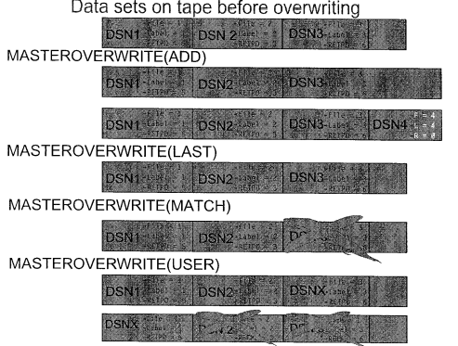
MASTEROVERWRITE

Slide 95
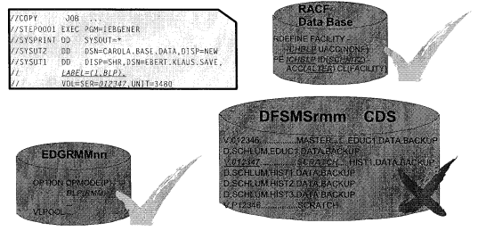
Option BLP – Read from Scratch Volume
Bypass label processing is being used to read from a scratch volume.
Volume to be read must be in USER or MASTER status.
To use BLP, need facility class resource ICHBLP authorization

Slide 96
Option BLP – Write to Master/Scratch Volume
BLP is being used to write to a scratch or master volume unless you request rmm to restrict BLP processing through EDGRMMxx.

Slide 97
RMM EXITS
RMM installation-wide exits
  EDGUX100
    Ignore foreign or duplicate volumes
    Use JCL, special expiration dates to manage volumes by setting VRS MV to retain dataset
    Set any expiration date including a zero value for a dataset
    Obtain information to create sticky Labels Request
    Record only first file on a multi-file volume
    Select scratch pool by Jobname or dataset name
  EDGUX200
    Return a volume to scratch status in an external inventory
    Prevent a volume from returning to scratch status
    Request rmm ignore the dataset information recorded for a volume

Slide 98
Related Exits
CBRUXCUA
  Change use attribute
CBRUXEJC
  Cartridge eject
CBRUXENT
  Cartridge entry
CBRUXVNL
  Volume not in library
EDGDFHSM
  Programming interface to EDGTVECT
IGXMSGEX
  Programming interface to EDGMSGEX
Notes:
Addition sample exits can be found in SYS1.SMPSTS. RMM supplies these exits so that it can interface with IBM system-managed tape libraries (CBRUXxxx) and DFSMShsm (EDGDFHSM or EDGTVEXT)

Slide 99
3.2 RMM with HSM and TSM

Slide 100
Running RMM with HSM
Update ARCCMDxx to retain hsm tapes using expiration dates
  SETSYS TAPESECURITY(EXPIRATION RACF)
  DEFINE DUMPCLASS( class -
  AUTOREUSE -
  TAPEEXPIRATIONDATE(DATE) -
  RETENTIONPERIOD(day))
Update ARCCMDxx to make hsm use a global scratch pool:
  SETSYS SELECTVOLUME(SCRATCH)
  SETSYS TAPEDELETION(SCRATCH)
Authorize HSM to the following resources in RACF class FACILITY
    Resource Access
    STGADMIN.EDG.MASTER UPDATE
    STGADMIN.EDG.RELEASE READ
    STGADMIN.EDG.OWNER.hsmid UPDATE
Notes:
EXPIRATION
DFSMShsm protects each tape backup, migration level 2, and dump volume with an expiration date. Each backup version, migration copy, or dump copy on the tape volume is protected by an expiration date by placing an expiration date of 99365 in the IBM Standard Data Set Label 1 (HDR1, EOV1, and EOF1).
To interface with RMM, HSM executes a tape volume deletion exit EDGTVEXT. RMM should reatin all hsm tapes until returns them via EDGTVEXT exit which committed by TAPESECURITY(EXPIRATION)

Slide 101
TSM Specifications
Specify permanent tape retention by entering the following TSM command:
  update devclass cartridge expiration=99365
Retain TSM tapes using vital record processing:
  RMM ADDVRS DSNAME(tsmprefix.**) COUNT(9999) CYCLES
Set up tape installation-wide exit to identify the deletion exit to the server by specifying in the server option file:
  DELetionexit EDGTVEXT

Slide 102
Unit 4. Vital Record Specifications
Define VRS policies for retention and movement
Identify VRS retention options for retaining datasets
Use RMM VRS masking facility for retaining datasets
Identify updates of the control data set during VRSEL

Slide 103
4.1 Vital Record Specifications

Slide 104
What kind of Retention?
Job Control language
  // LABEL=EXPDT=2004/137 or // EXPDT=2004/137
  // LABEL=RETPD=730, or // RETPD=730
Virtal record specification
  data set name and job name
  Volume serial number
  Mangement class
  Management value (EDGUX100 user exit)
Expiration date and VRS are used together by rmm to determine the retention of a volume
Notes:
RMM does not use special dates. If a date is used and not overridden, RMM retains the dataset until the expiration date is reached. Dataset and volumes can also be retained through the use of VRS policies.

Slide 105
VRS Basics
3 type of vital record definitions available with ADDVRS.
  data set name
  RMM ADDVRS DSNAME( ) JOBNAME( )
  Volser
  RMM ADDVRS VOLUME( )
  A name to provide a continuation of a VRS rule with a chain of VRS
  RMM ADDVRS NAME( )
Notes:
Retention can be speicified via cycles, days, or days since last reference.

Slide 106
Types of Retention Policies
Data set name by cycles
RMM ADDVRS DSNAME('SCHLUM.*.DATA') CYCLES COUNT(5)
RMM ADDVRS DSNAME('D99005') CYCLES COUNT(5)
Data set name by elapsed days
RMM ADDVRS DSNAME('SCHLUM.BACKUP.**') DAYS COUNT(30)
Data set name by days last referenced
RMM ADDVRS DSNAME('SCHLUM.BACKUP.DATA') LASTREFERENCEDAYS COUNT(7)
Data set name until specific date
RMM ADDVRS DSNAME('SCHLUM.**') DELETEDATE(2002/225)

Slide 107
Types of Retention Policies
Data set name while cataloged
RMM ADDVRS DSNAME('SCHLUM.BACKUP.DATA') WHILECATALOGED
RMM ADDVRS DSNAME('M99000') WHILECATALOGED
Data set name until expired
RMM ADDVRS DSNAME('SCHLUM.BACKUP.DATA') UNTILEXPIRED
Data set name and job name
RMM ADDVRS DSNAME('**') JOBNAME(CHECK)
Data set open status
RMM ADDVRS DSNAME('ABEND') CYCLES COUNT(1)
RMM ADDVRS DSNAME('OPEN') LASTREFERENCEDAYS COUNT(2)
Notes:
WHILECATALOG
will retain data sets as long as they are cataloged
UNTILEXPIRED
Retains a dataset until the volume expiration date is reached or until the data set is no longer retained (because of a VRS rule), 如果没有UNTILEXPIRED，即使dataset not retained, 也不会expire?
ABEND/OPEN
Special data set status can be addressed by protected data set name of ABEND and OPEN. These VRS match if ABEND or OPEN flags in the DSN record in CDS are set, regardless of real name of the dataset.
; M99000 isn't real dataset names. they're connected to a dataset through the use of a MC or MV.

